Slide 1
Premier League – 2025/2026 Season
Defensive Midfielder Offensive and Defensive Activity Analyses
----
Throughout the first 5 PL matches

Slide 2
Chapter I - Offensive Activity

Slide 3
Idée de plan : se baser sur les thèmes de jeu enseignés dans les formations CFF:
Commencer par ‘Conserver Progresser’ :
Carries Analysis
Passes Analysis
Poursuivre avec ‘Déséquilibrer Finir’ :
xG et xA
Chances created and Touch in the box

Slide 4
Activity in goal scoring and opportunities

Slide 5
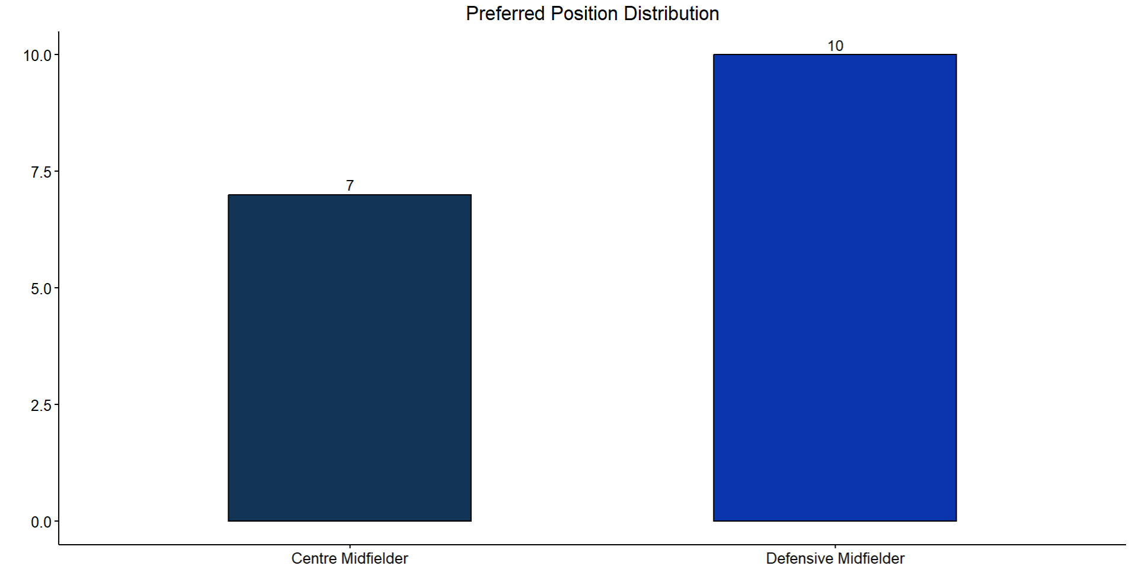

Slide 6
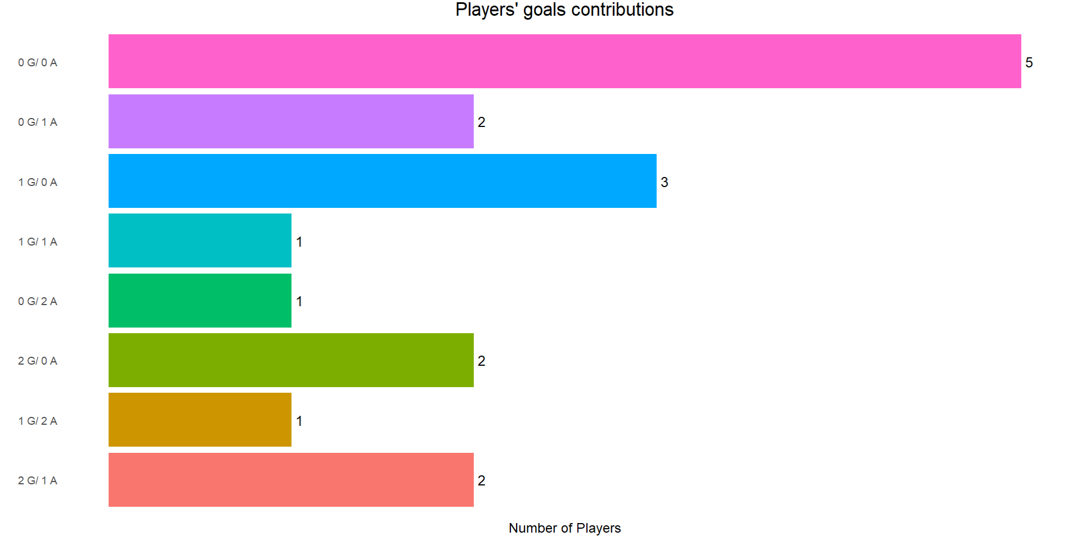
T.Adams – S.Lukic – S.Tonali – S.Berge – J.Ward-Prowse
E.Anderson – D.Rice
I.Gueye – Y.Ayari – B.Guimaraes
A.Stach
G.Xhaka
M.Zubimendi
T.Reijnders
E.Fernandez – R.Gravenberch

Slide 7
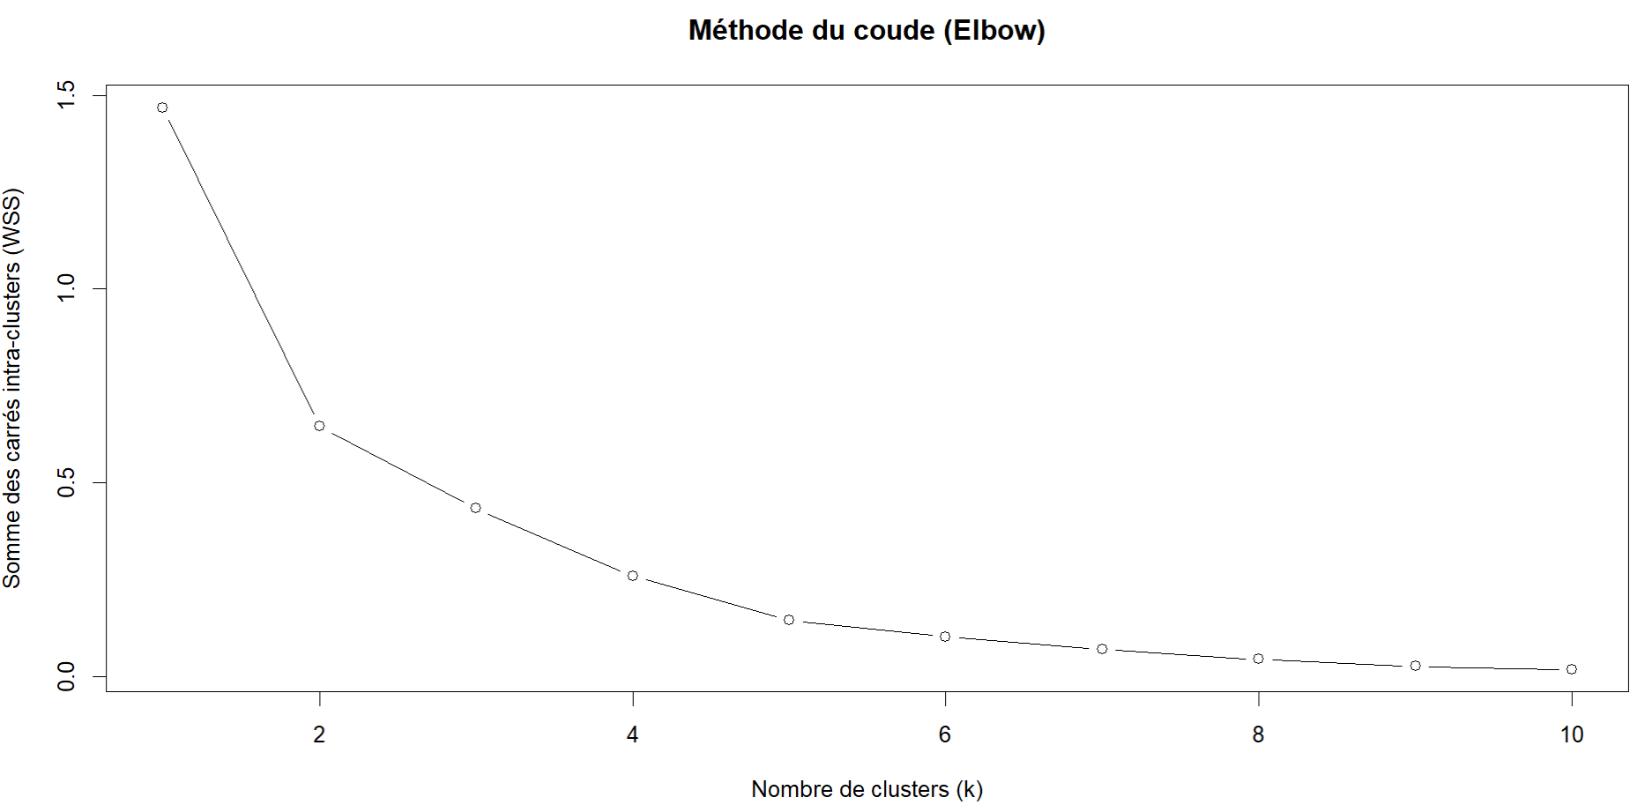

Slide 8
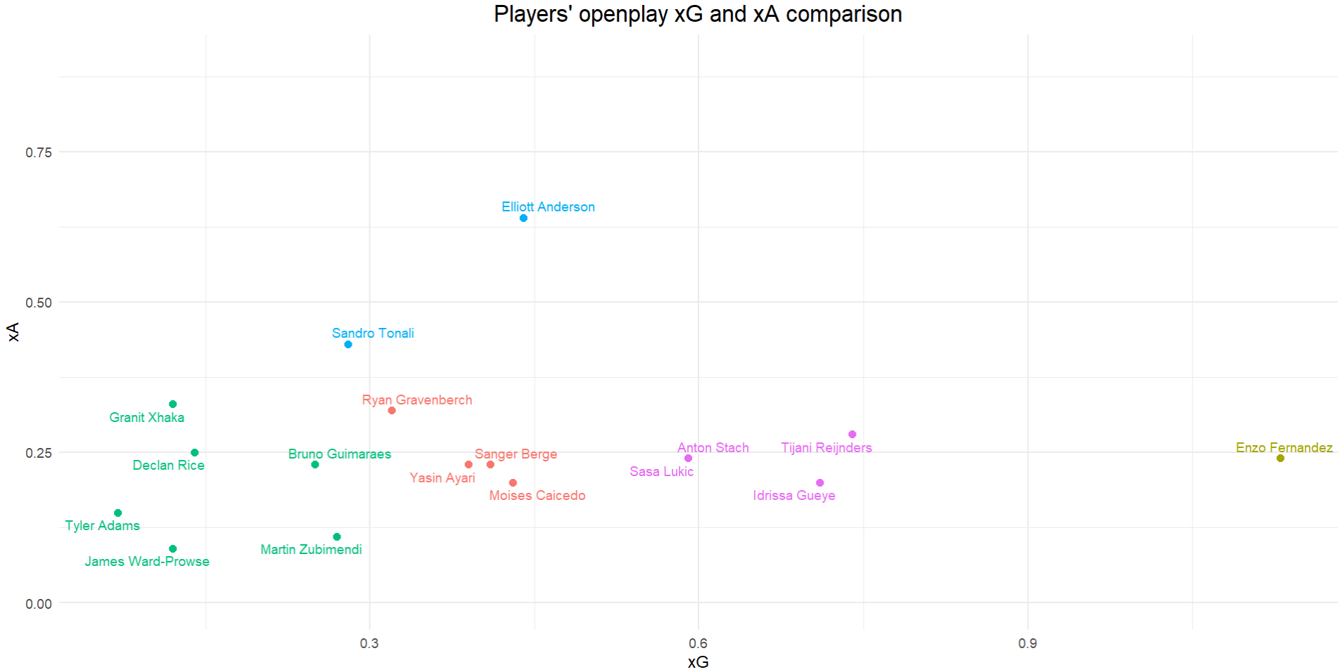
Creators
OP xAssists
Offensive threats
Neutral
Goal-oriented
Not offensively impactful
OP xG

Slide 9
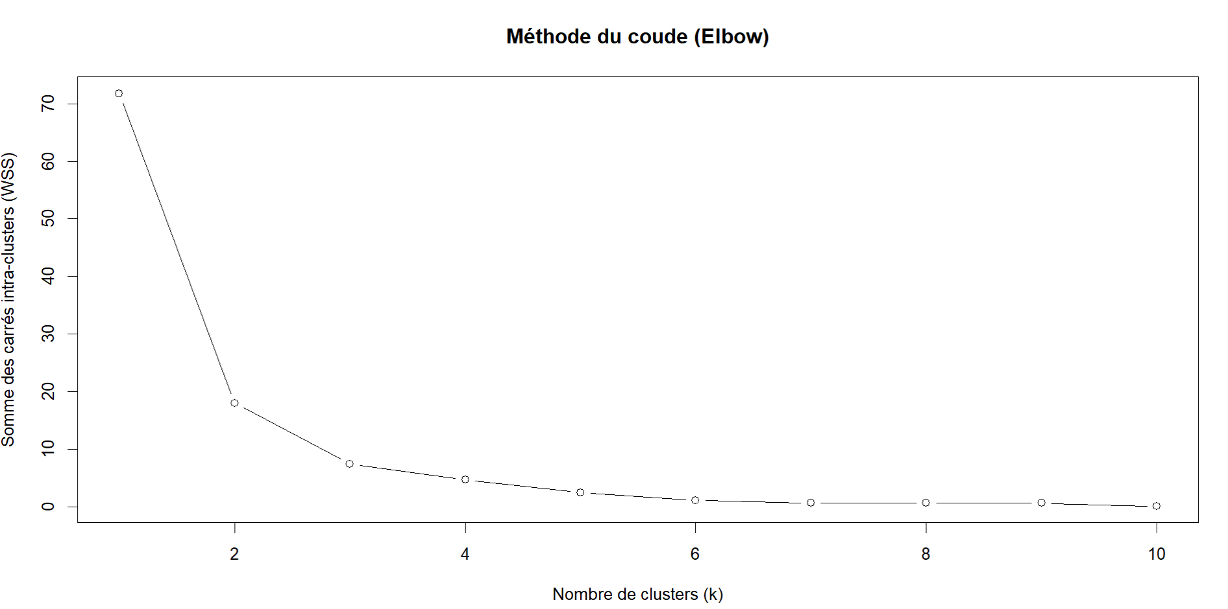

Slide 10
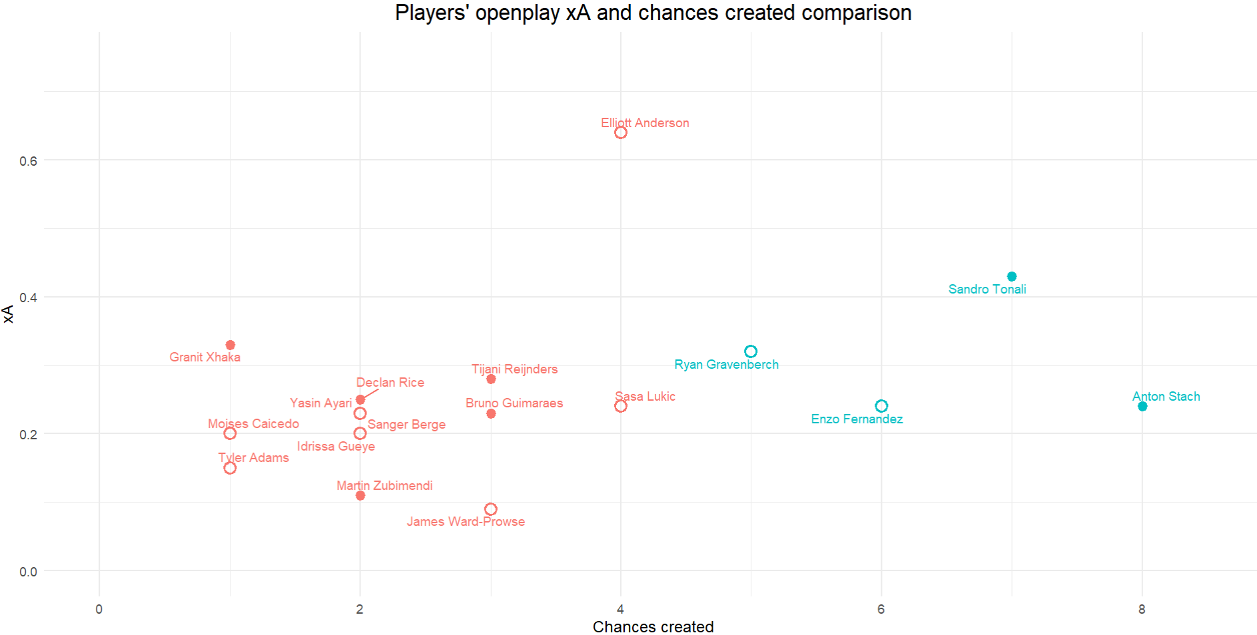

xAssists

Slide 11
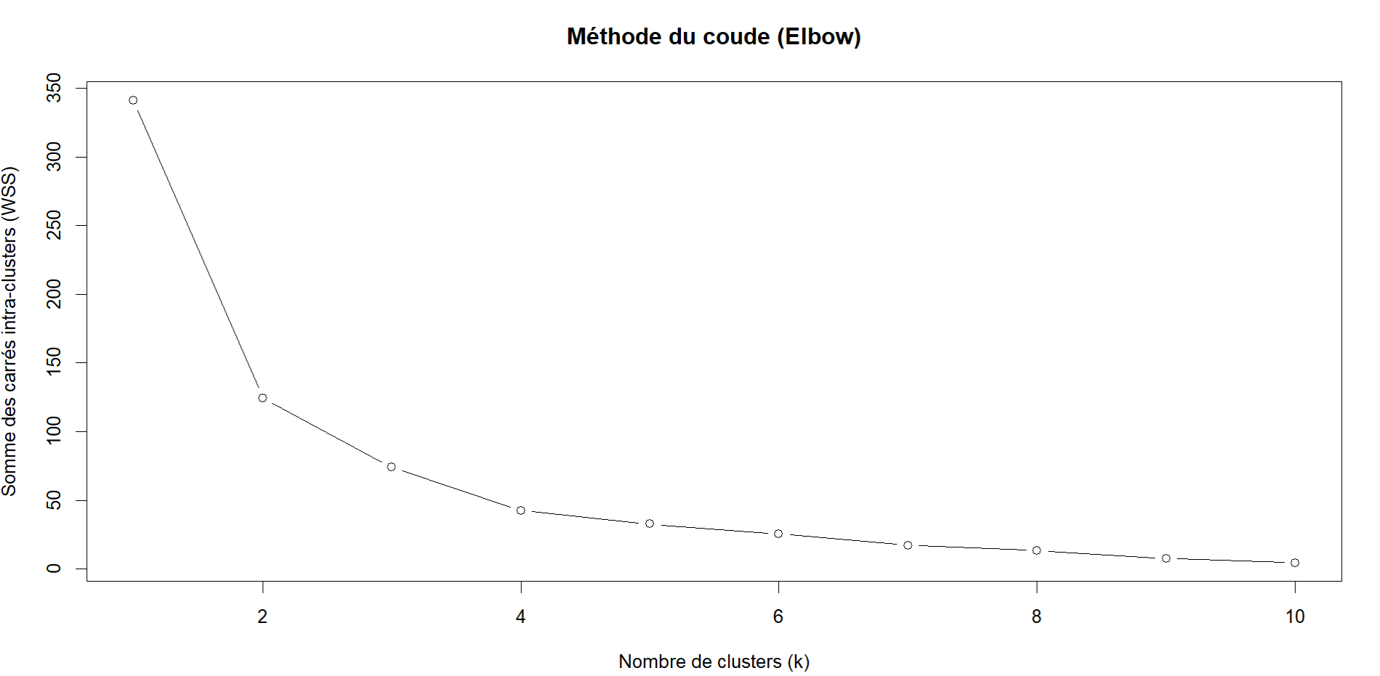

Slide 12
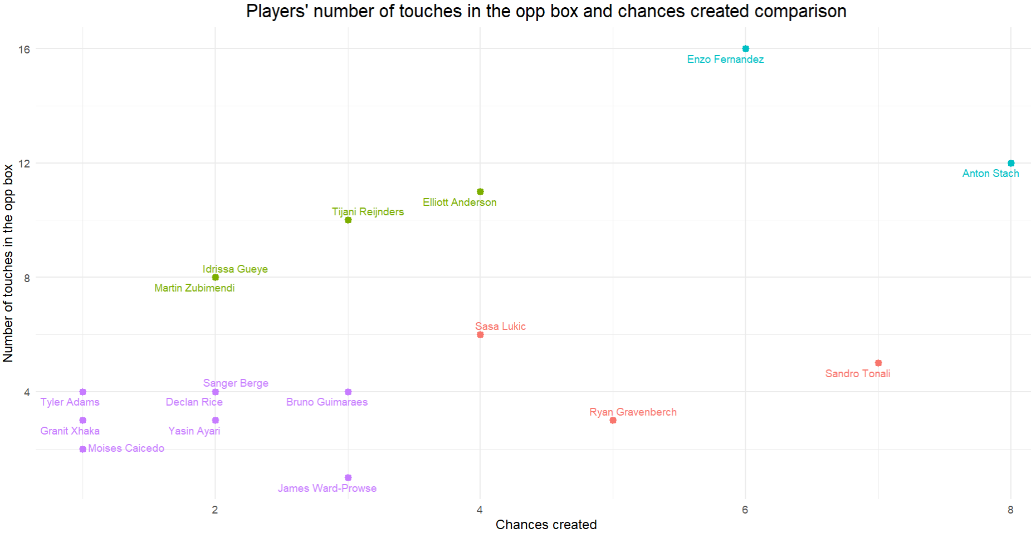
Inside-the-box threats
Inside-the-box options
Outside-the-box threats
Offensive builders

Slide 13
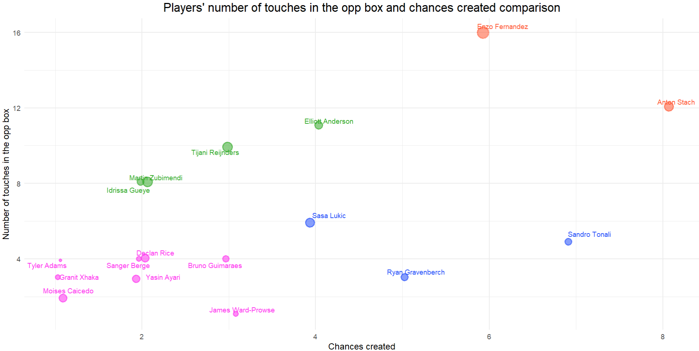
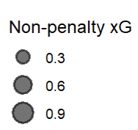
Inside-the-box threats
Inside-the-box options
Offensive builders
Outside-the-box threats

Slide 14
Activity in possessions and in building opportunities

Slide 15
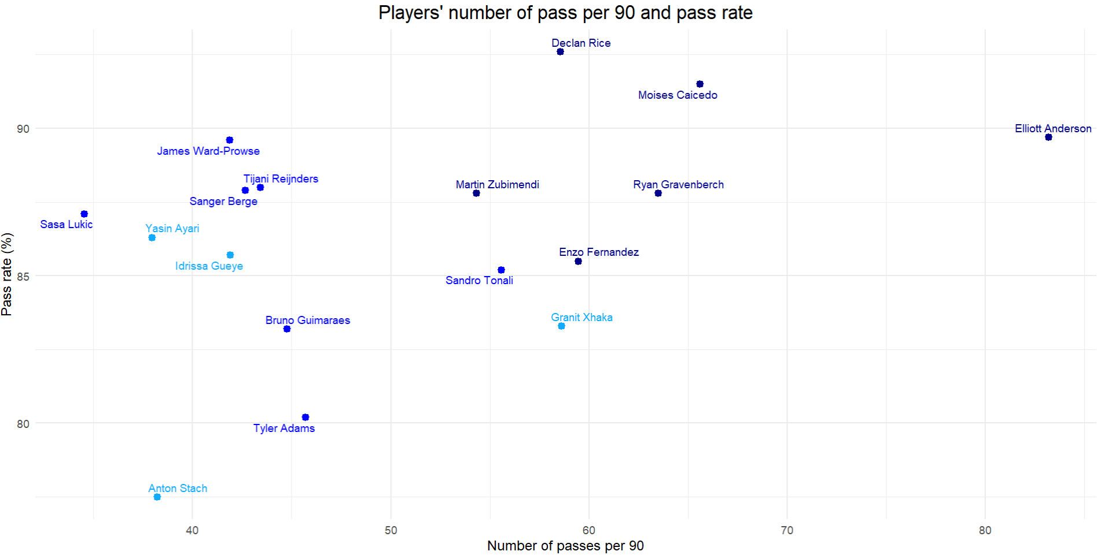
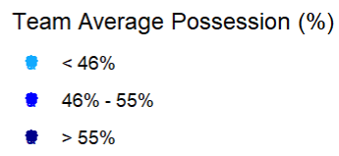

Slide 16
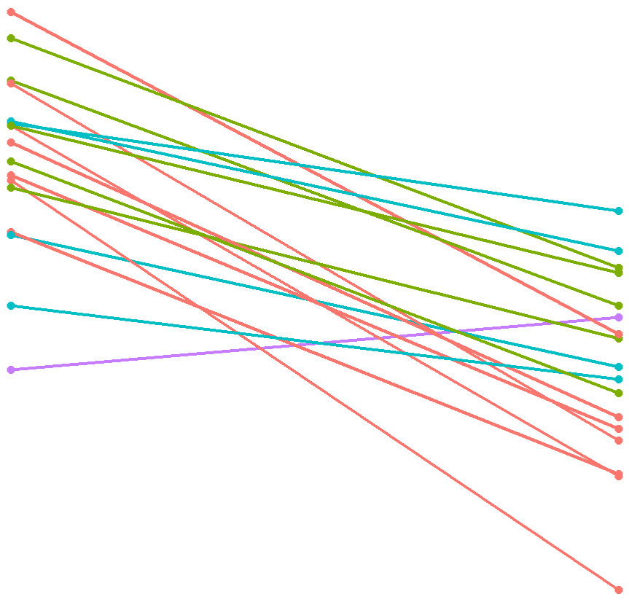
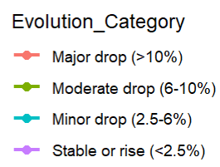
Pass completion Rate Evolution
Interactive figure link
S.Berge
Pass Rate Evolution Category
T.Reijnders
M.Caicedo – R.Gravenberch
E.Anderson
A.Stach
D.Rice - S.Tonali
T.Adams – B.Guimaraes
Y.Ayari
S.Lukic – I.Gueye – J.Ward-Prowse
G.Xhaka
M.Zubimendi
E.Fernandez
Total Passes
Final 3rd Passes

Slide 17
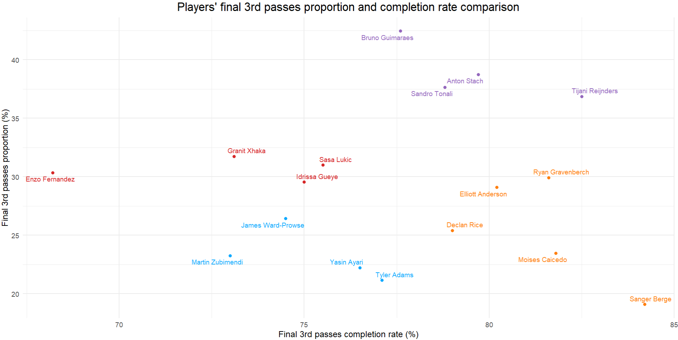
Final 3rd experts
Inaccurate
Final 3rd players
Accurate
Final 3rd players
Non Final 3rd players

Slide 18
Ball carries activity

Slide 19
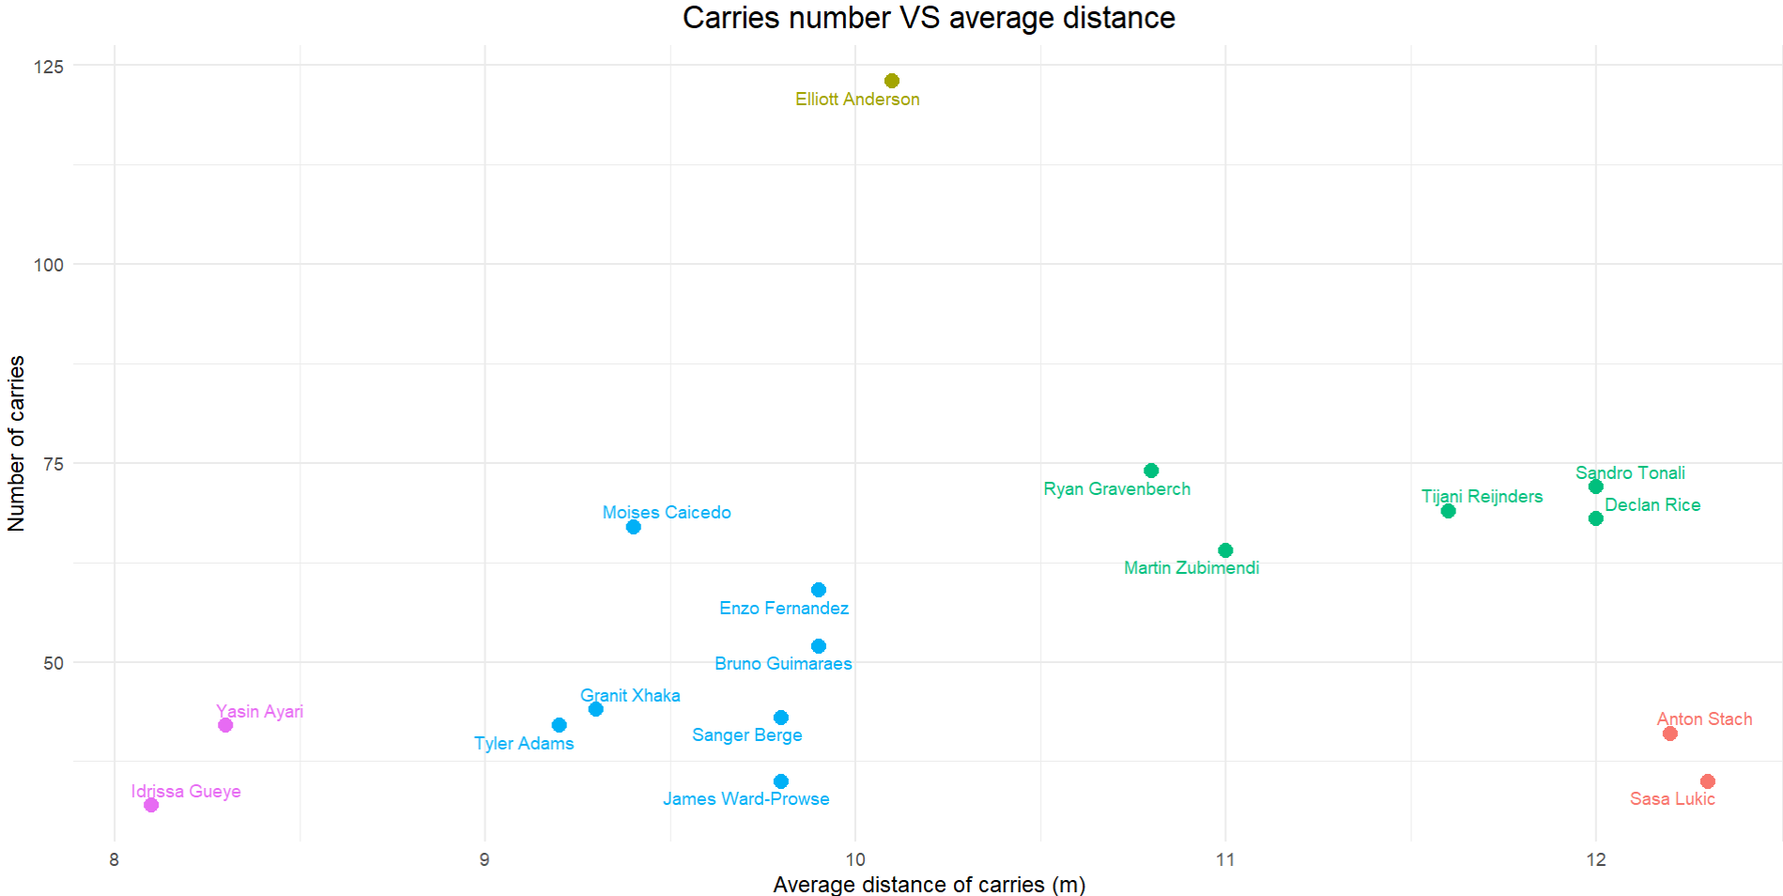
Huge number/medium distance
Medium number
/long distance
Small number
/medium distance
Small number
/long distance
Small number
and distance

Slide 20
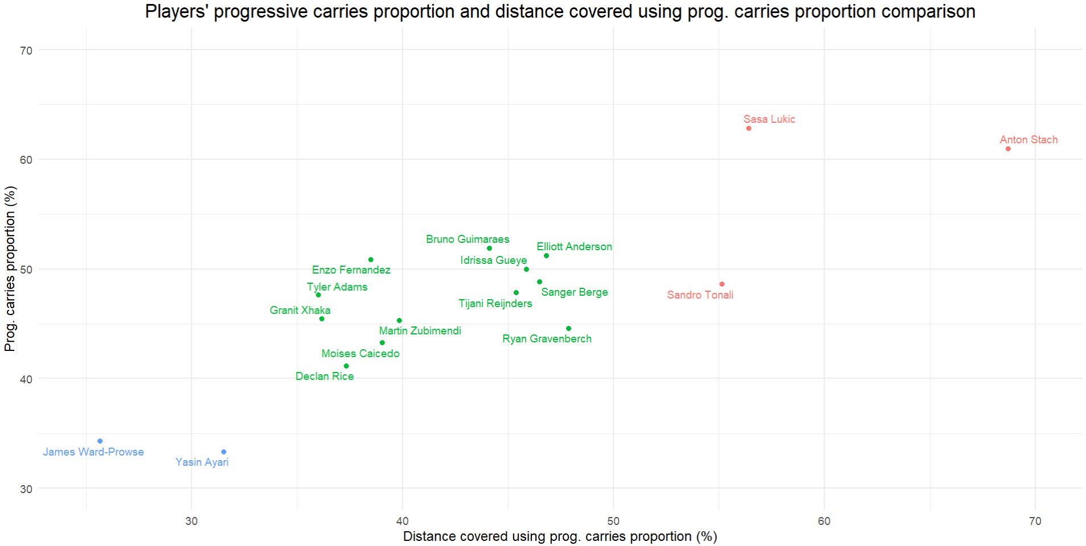
Low-to-intermediate progressive players
Progressive plays specialists
Non-progressive players

Slide 21
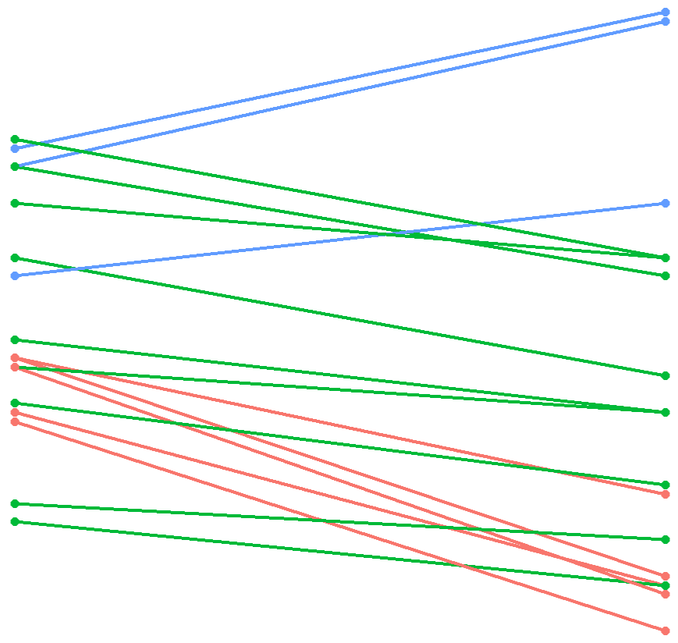
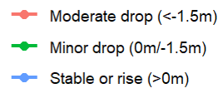
Average carries distance Evolution
Interactive figure link
A.Stach
S.Tonali
R.Gravenberch
Average carries distance evolution Category
S.Lukic – T.Reijnders
D.Rice
M.Zubimendi
E.Anderson – S.Berge
M.Caicedo
B.Guimaraes
Y.Ayari
E.Fernandez
G.Xhaka - I.Gueye
J.Ward-Prowse
T.Adams
Total carries
Progressive carries

Slide 22
Principal Component Analysis (PCA) and Hierarchical Classification on principal components (HCPC)

Slide 23
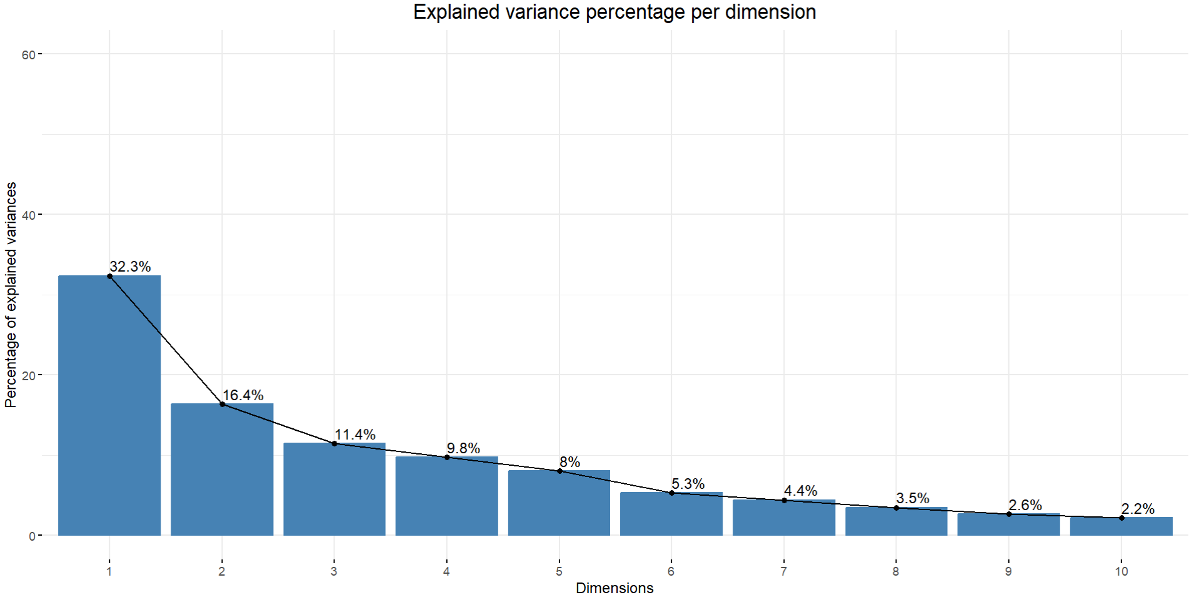

Slide 24
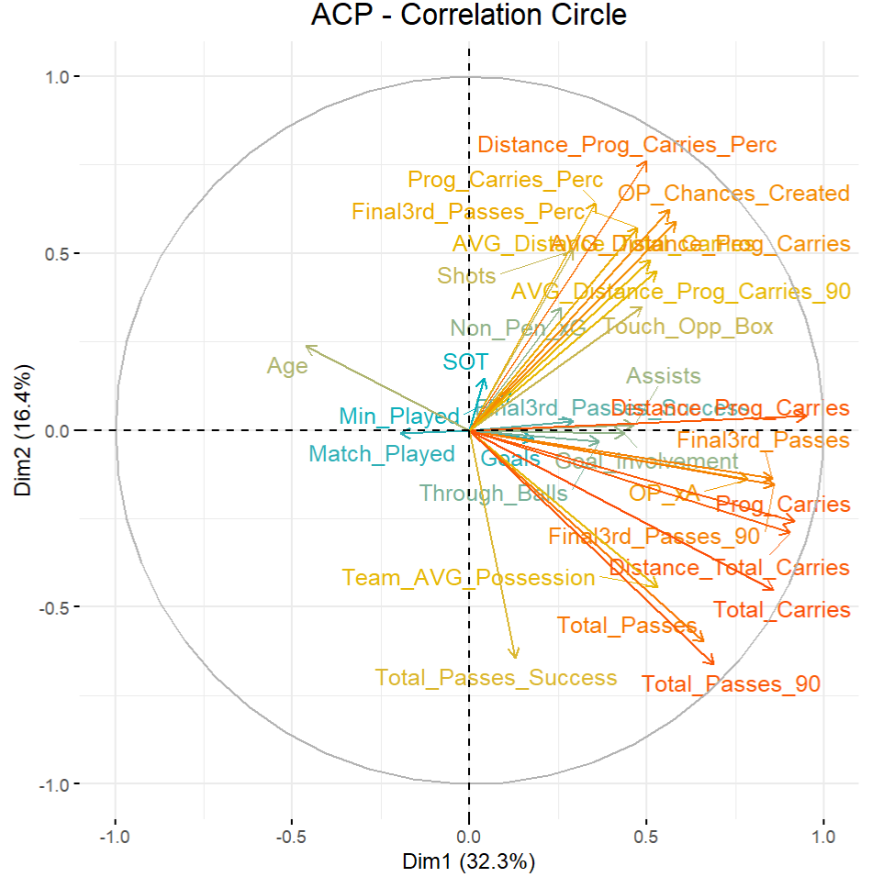
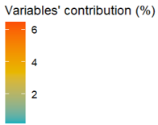

Slide 25
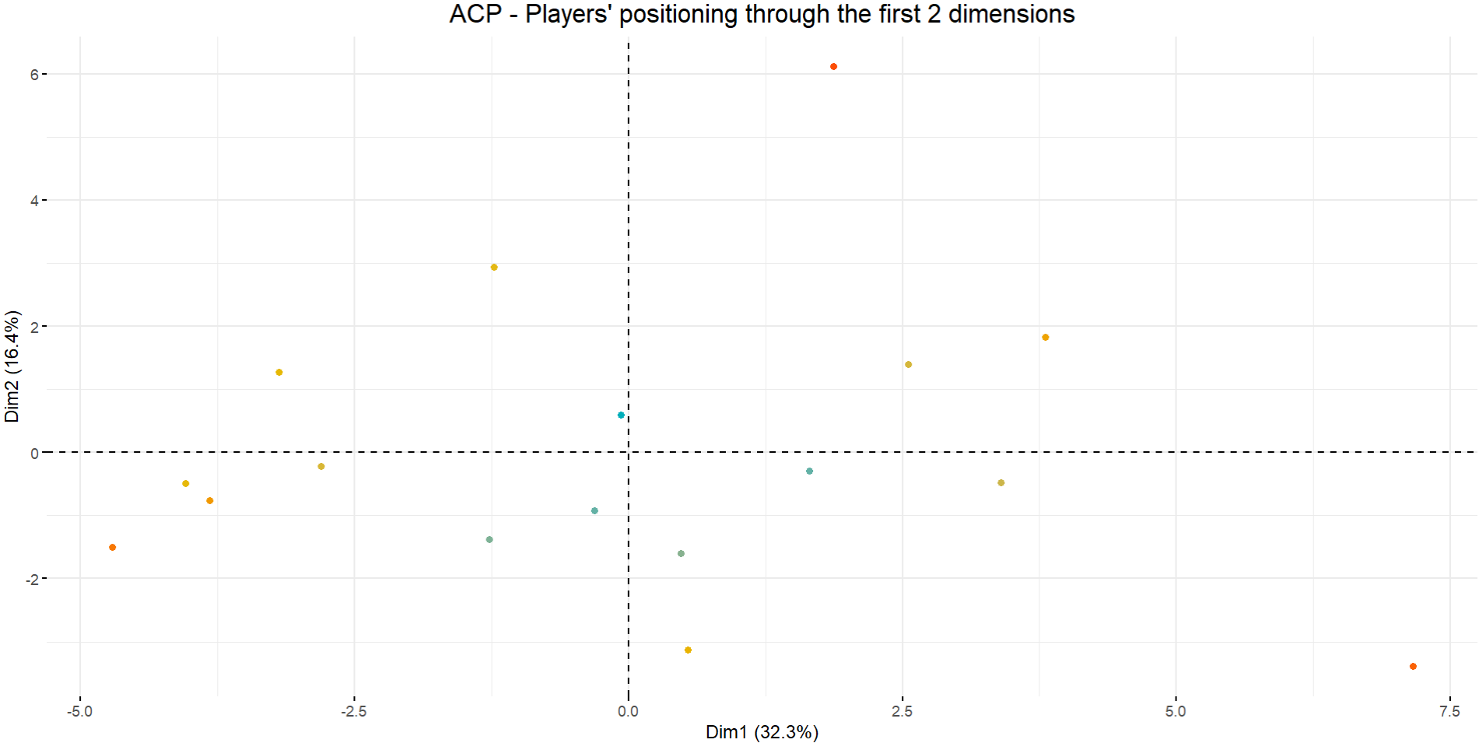
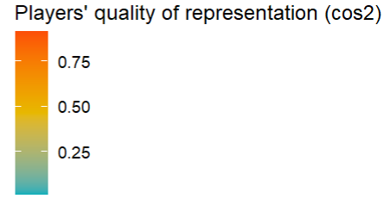

Slide 26
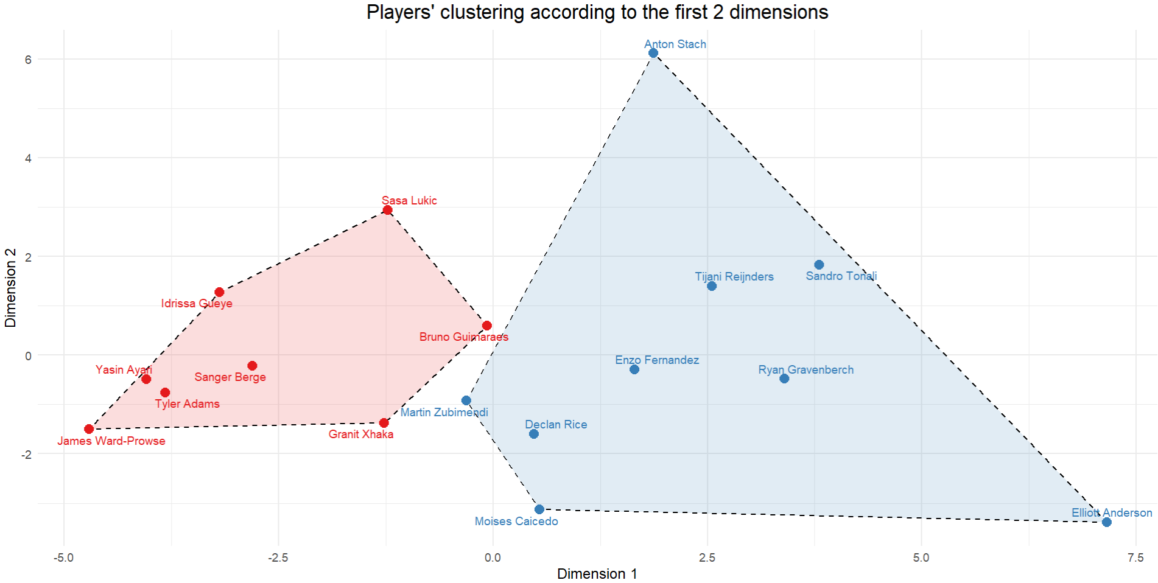
Cluster 2
Cluster 1

Slide 27
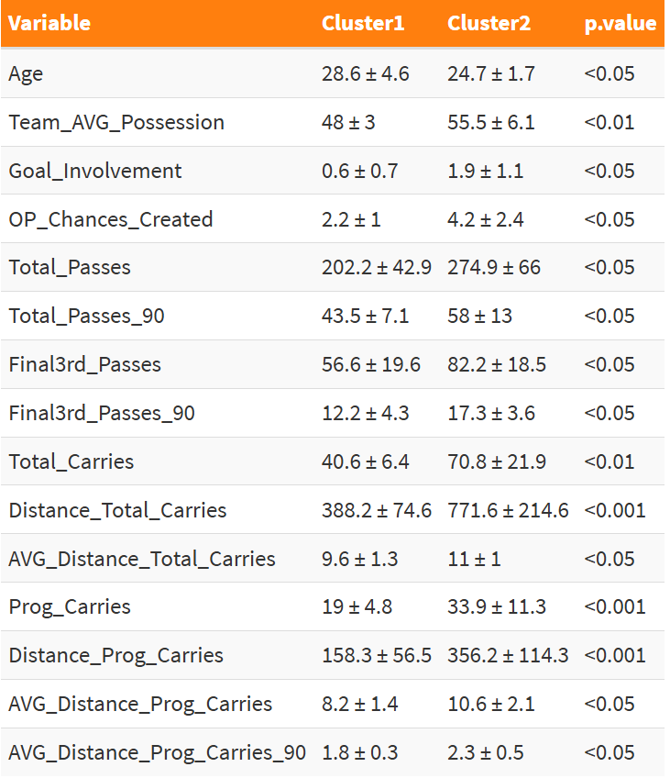
Statistical comparison of variables between the two clusters
Interactive table link

